Slide 1
Avocado
US centric study from 2015 to 2021

Slide 2
Contents
Questions & hypothesis
Approach and analysis
Technical challenges
Q1. price and volume
Q2. regions and sales
Q3. product preference
Q4. Mirror image?
Deeper analysis
New metric: Purchasing power
Results

Slide 3
Questions & hypothesis
Does the price have an influence on the volume?
Hypothesis: yes, the price has an influence on the volume and vice versa
Which areas consumed avocados the most from 2015 to 2021?
Hypothesis: mostly the highly developed areas because of the vegetarian and vegan trends
The plu4770 being the biggest Hass variety, is it also the one consumed the most?
Hypothesis: yes because the consumer tends to go for the cleanest, the most beautiful, the biggest product
Is the trend in the most consuming city an image of the general trend in the U.S?
Hypothesis: yes

Slide 4
Approach and Analysis
Data tables downloaded from hassavocadoboard.com (primary source)
Formatted, compiled and cleaned in one single dataset
The columns AveragePrice, TotalVolume, Year, Region, the different plu codes will be considered to answer our questions
Statistical inference and graphical visualization will be employed

Slide 5
Technical challenges
The dataset being clean enough, we have missing values in the “bags” column so they won’t be considered
Problem with the ‘region’ field: there are not only cities but also whole region of the United States such as TotalUS, California, SouthCentral, NorthEast so they’ll have to be put separately

Slide 6
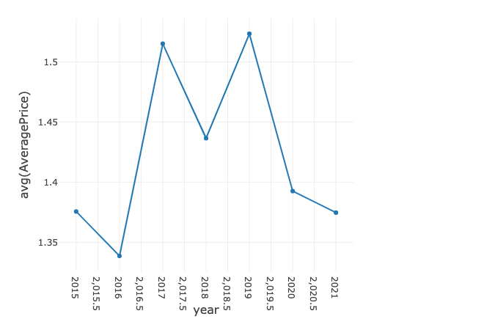
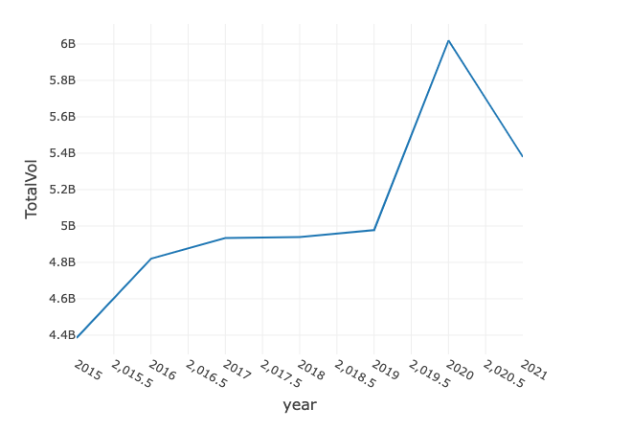
Q1. Price and Value
Aside from the price decrease from $1.5 to $1.3 from 2019 and 2020 which also showed an increase of 1 billion in sales, there are not strong correlations between the price and volume

Slide 7
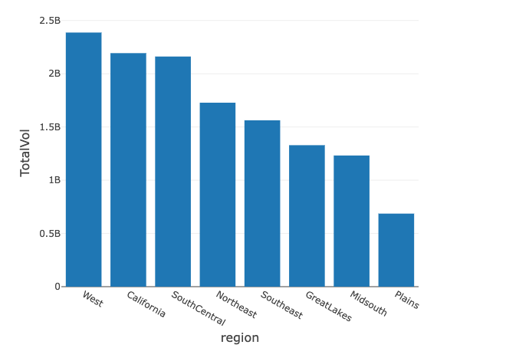
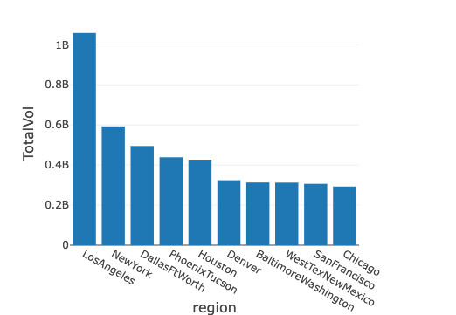
Q2. Regions and sales
Looking at the cities, we see Los Angeles, New York, Houston, Denver, San Francisco, Chicago as the cities who consume the most.

Slide 8
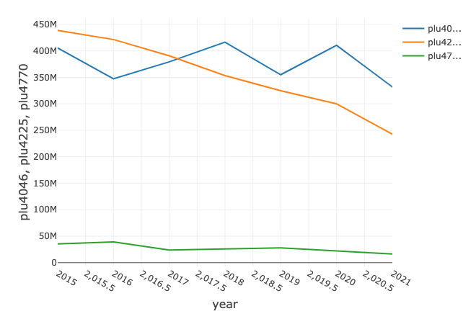
Q3. Product preference
The most popular avocado variety is the plu 4045, the small size avocado

Slide 9
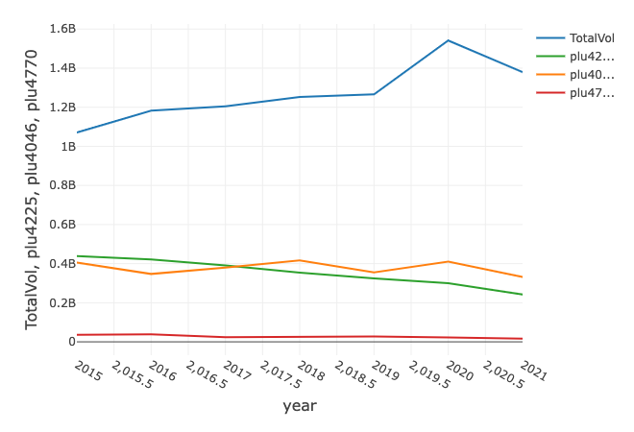
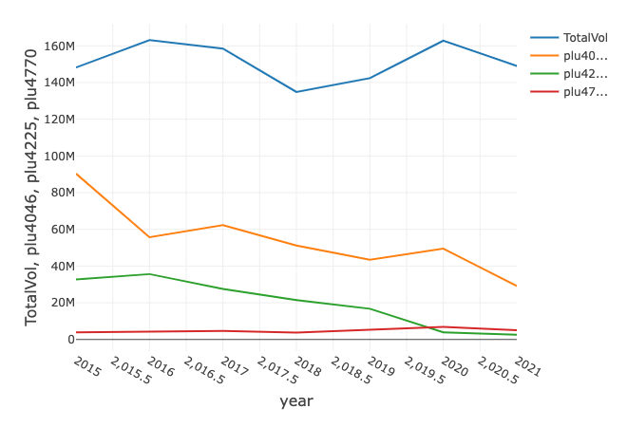
Q4. Mirror image?
Volume in the U.S from 2015 to 2021 Volume in Los Angeles from 2015 to 2021

Slide 10
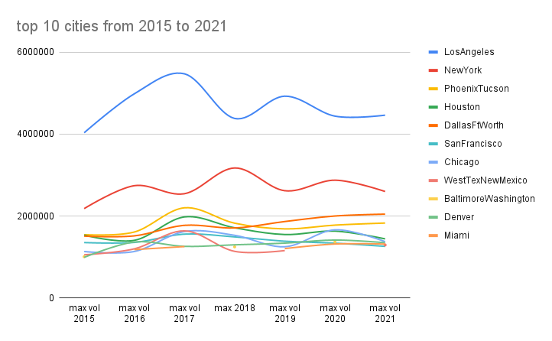
DEEPER ANALYSIS
Los Angeles & New York are the two majors contributors to the sales of avocados in the U.S followed by Phoenix, Houston and Dallas

Slide 11
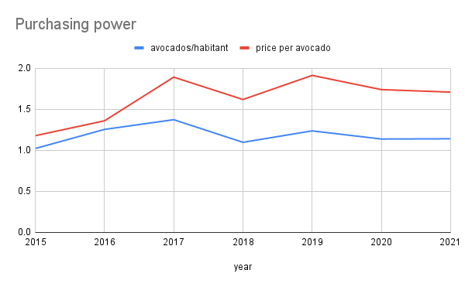
NEW METRIC: Purchasing power (Los Angeles)
In 2018, the price per avocado dropped as well as the number of avocados per habitant, which corresponds with the drop of total volume that year.
We also see that despite the price increase, the quantity bought doesn’t fluctuate much

Slide 12
Final results
1. Does the price have an influence on the volume?
In a sense yes but it is not significant enough to have an influence, other variables come into place.
2. Which areas consumed avocados the most from 2015 to 2021?
West, California and South Central have consumed the most avocados from 2015 to 2021. Los Angeles is the city where the most avocados were sold during that period (1.05 billion avocados sold)
3. The PLU4770 being the biggest Hass variety, is it also the one consumed the most?
Quite the opposite, the PLU4770 is the least sold while the smaller one, the PLU 4046 is now the one sold the most. However it would be important to compare the production units to the units sold to see if the fact that the PLU4770 being sold the least is because it is also the least produced.
4. Is the trend in the most consuming city an image of the general trend in the U.S?
No, the trend in Los Angeles tends to be stabilized around 150 million every year while the general trend in the U.S tends to increase over the years.
5. Los Angeles and New York consume the most avocados, followed by Dallas, Houston, Phoenix, Chicago and San Francisco.
6. Despite the price increase, the general cost of living increasing as well, the number of avocados bought per habitant doesn’t fluctuate significantly

